Slide 1

DSC530 Final Term Project
By: Lee Johnston

Slide 2
Dataset File In Use:
The data file that I have chosen to use is called: ‘FIFA World Cup 2022: Complete Dataset’
Dataset File Link: Kaggle.com/datasets/die9origephit/fifa-world-cup-2022-complete-dataset’
This dataset contains the statistical recap of all the teams at the last world cup in 2022. Even for statistics such as ‘Expected Goals’ or ‘Expected Assists Per Game’. I will use this dataset to find the relationships between certain statistics and answer an age-old question about European Football/Soccer.

Slide 3
Statistical Question/Hypothesis:
The question I have chosen to ask is ‘ Is possession an overvalued/unnecessary statistic in European Football?’.
While pursuing an answer to this question I will seek out the relationship between certain variables to find out if possession is truly as important as people see it.
This analysis will be conducting on a 6-week tournament and not European football as a whole, but will be used to represent the sport in general for the sake of this hypothesis.
My personal/biased opinion is that possession is necessary but not as important as it is perceived to be.

Slide 4
Selected Variables: Key: (A European Football match is 90 minutes long in duration) (An assist is a goal that was created by the pass from the goal scorer’s teammate)
The following variables will be used for this analysis.
-Possession: The percentage of a match that a team controls the ball
-Goals 90: The amount of goals scored during a match
-Expected Goals 90: The amount of goals statistically expected to be scored
-Assists 90: The amount of goals assisted in a match
-Expected Assists 90: The amount of goals statistically expected to be assisted

Slide 5
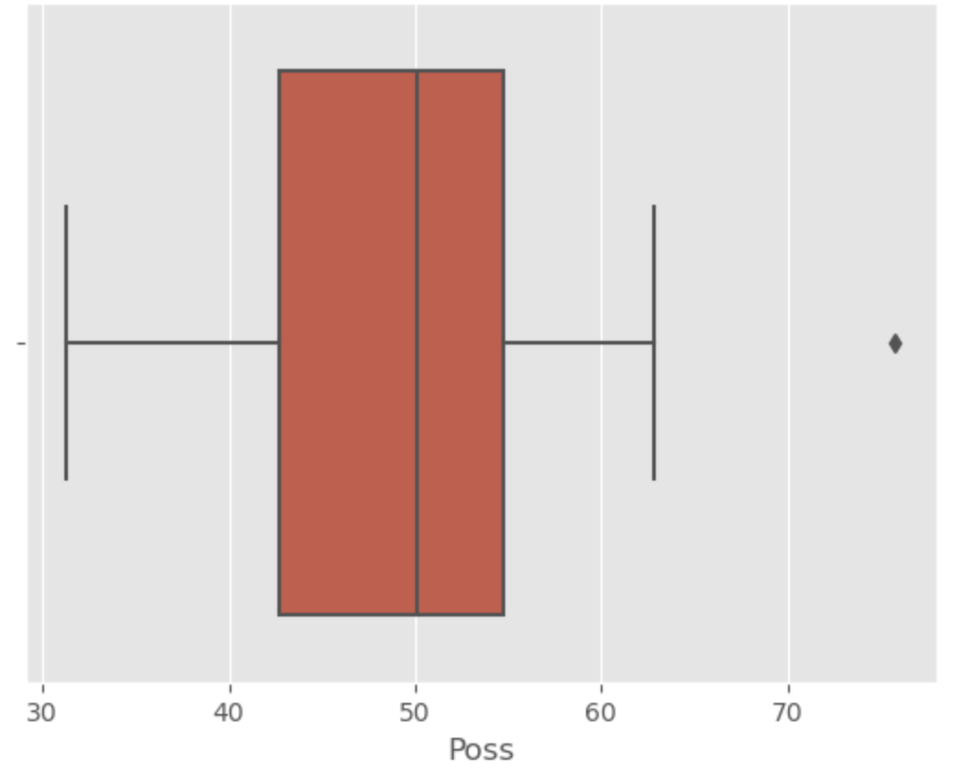
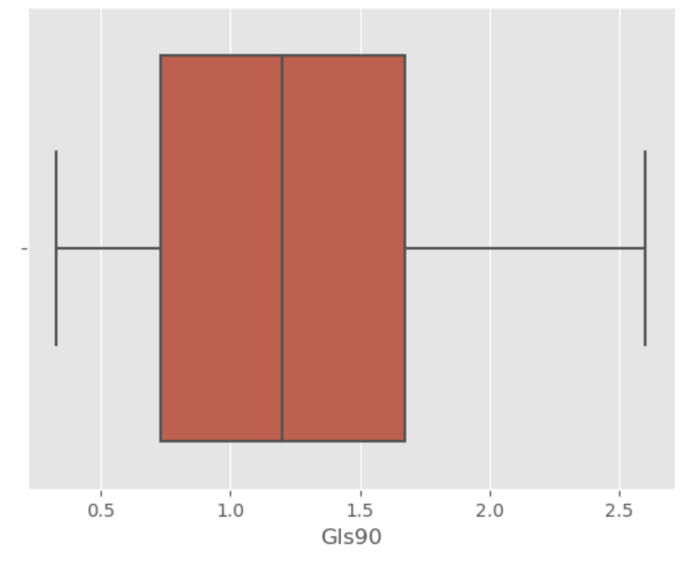
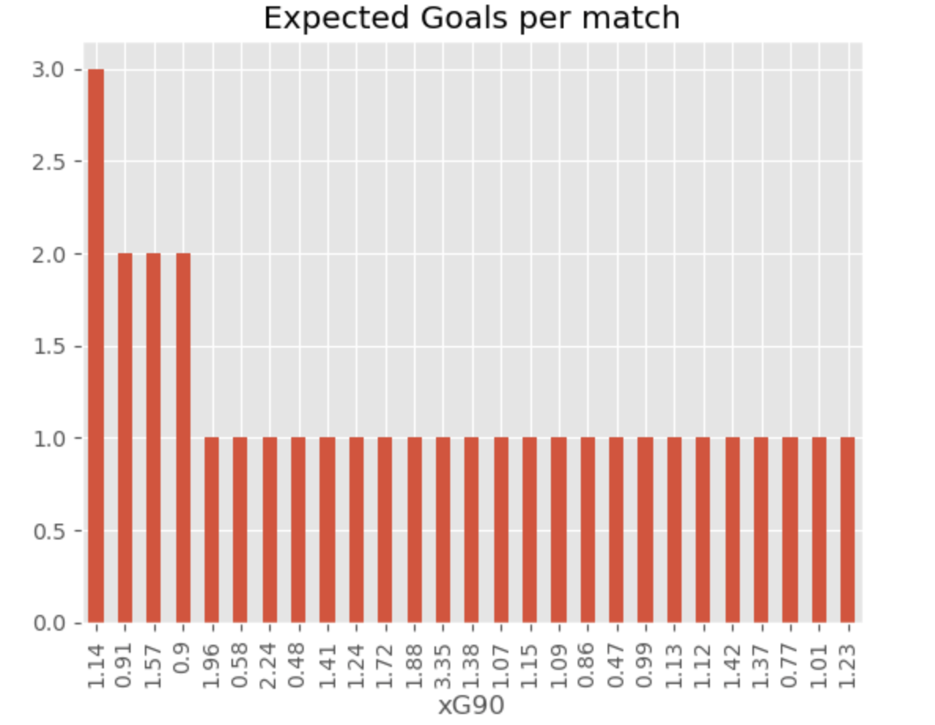
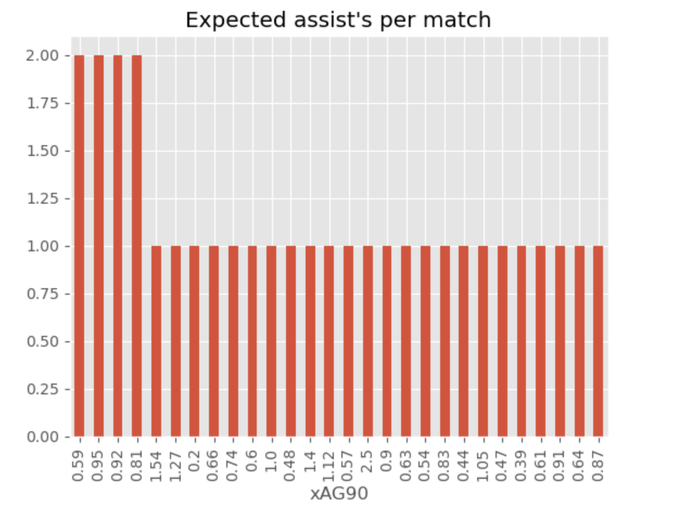
Variable Histograms: Histograms on the variables in question to begin to develop an understanding of the material.

Slide 6
Descriptive Characteristics: Below are the Mean, Median, Mode, Tail & Spread Values of the variables
Possession: 49.4, 50.1, 51.3, 0.37, 9.45
Goals 90: 1.19, 1.2, 0.33, 0.38 and 0.65
Expected Goals 90: 1.25, 1.14, 1.14, 1.86 and 0.55
Assists 90: 0.83, 3.0, 1, 0.82 and 0.54
Expected Assists 90: 0.84, 0.81, 0.95, 2.09 and 0.42

Slide 7
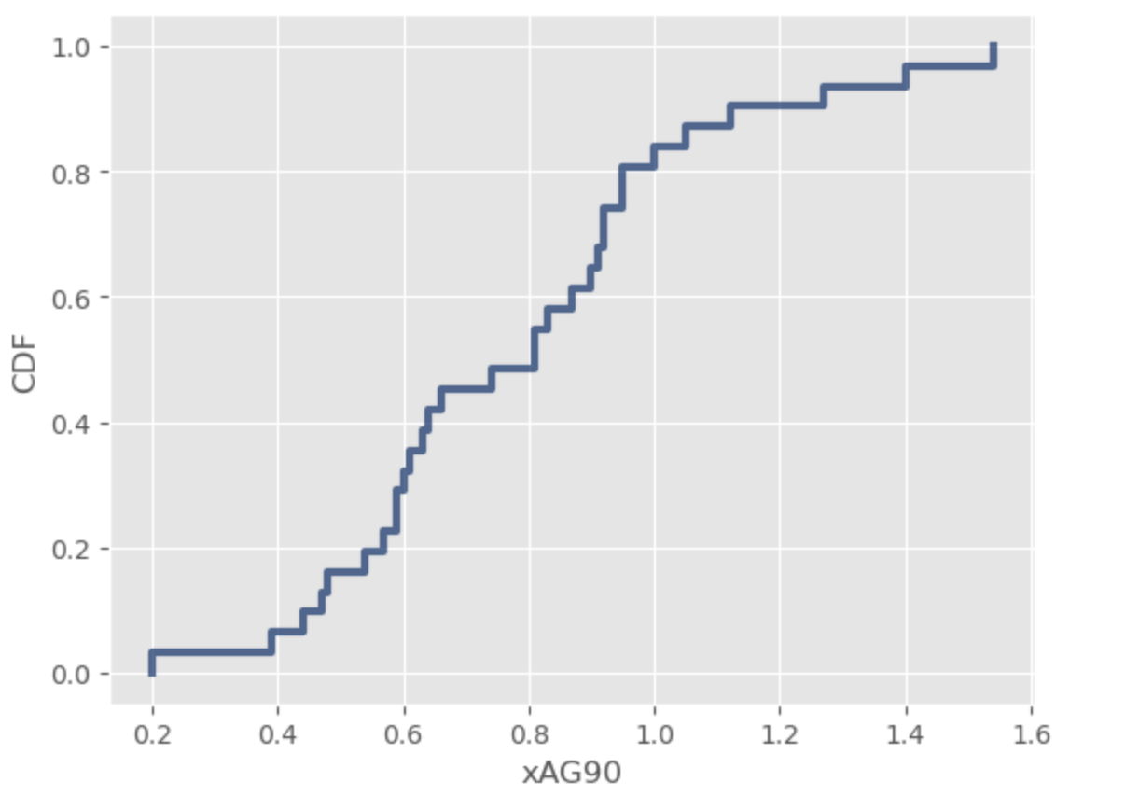
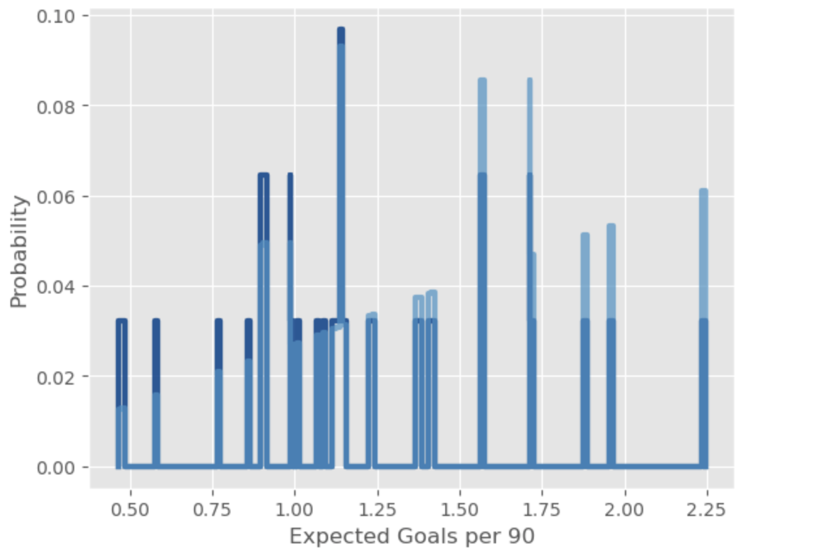
Dataset PMF & CDF: CDF PMF

Slide 8
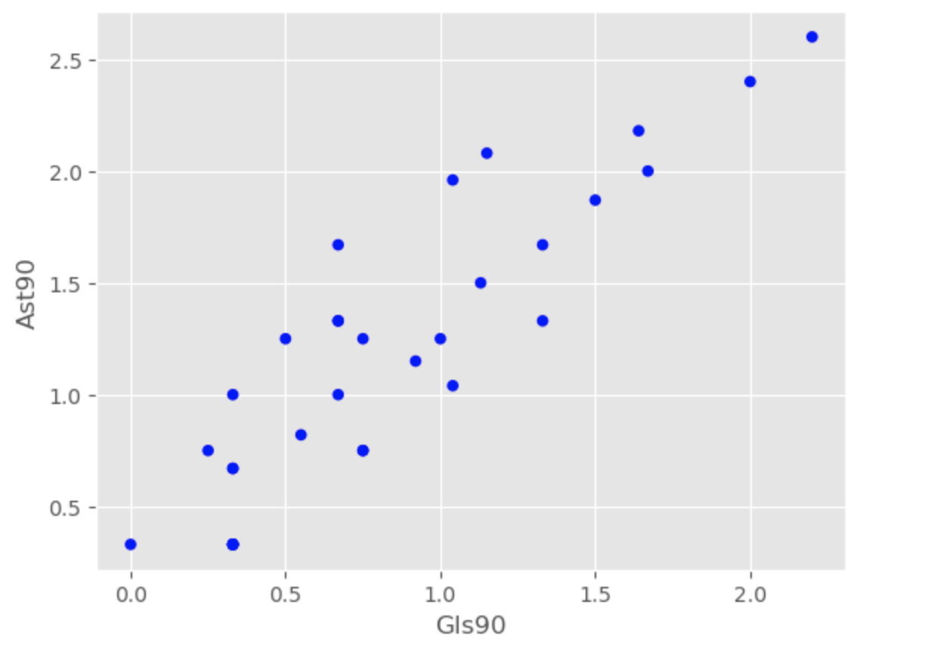
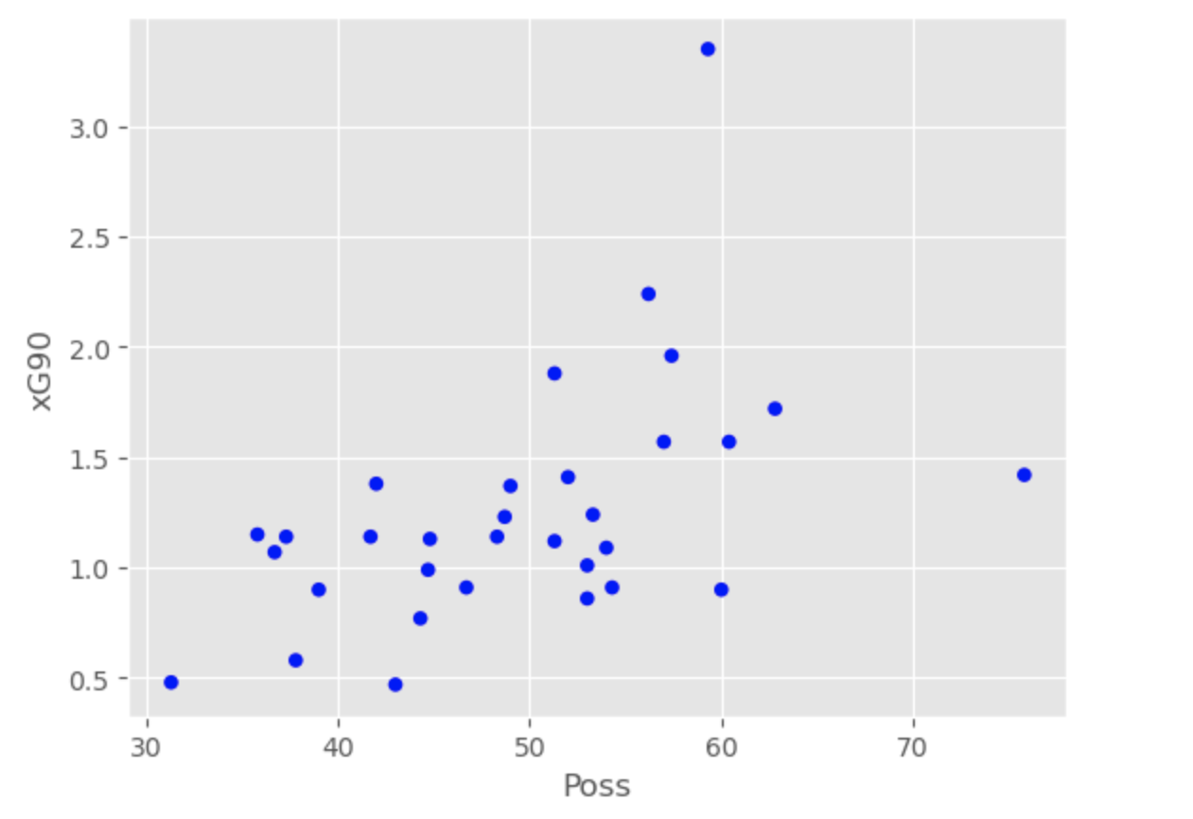
Dataset Scatterplots: Scatterplots of Ast90-Gls90 and Poss-xG90 to find a better understanding of the relationships between the variables.

Slide 9
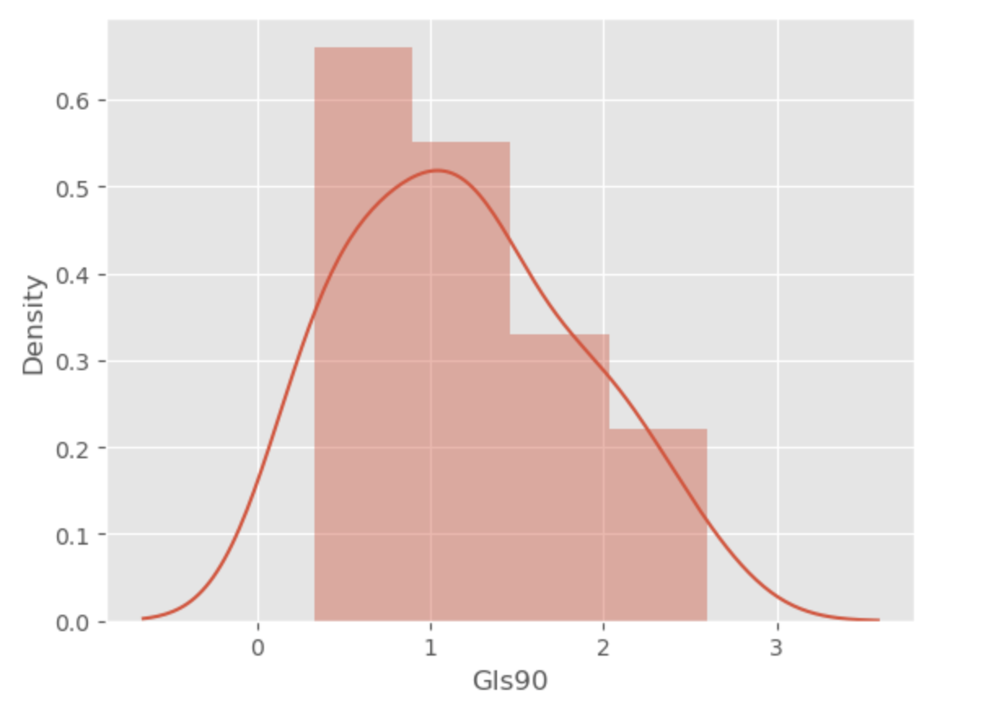
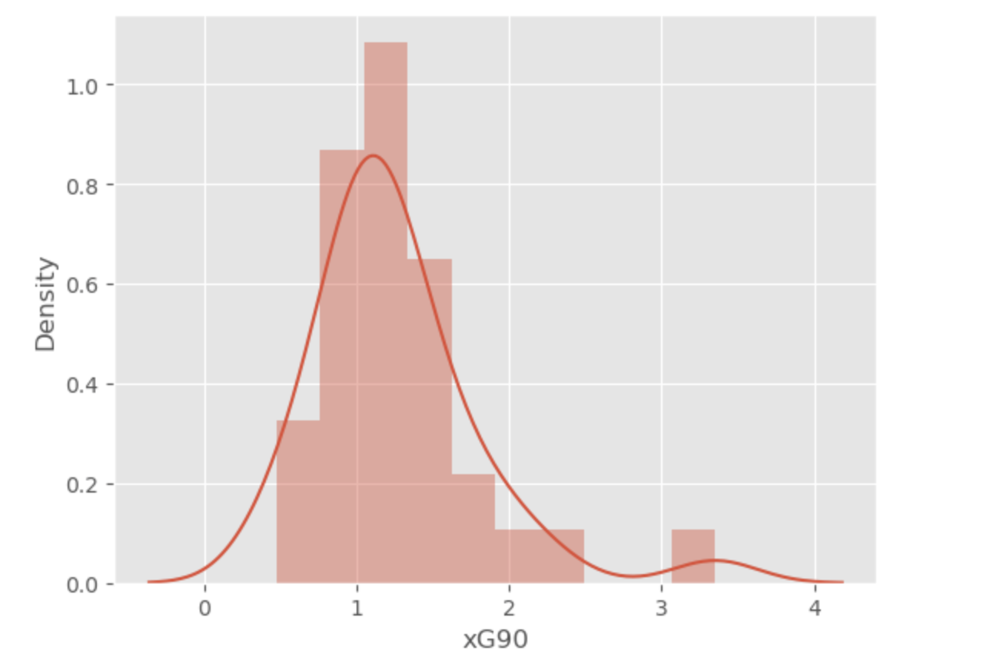
Dataset Analytical Distribution: Graphics to understand the distribution between the probability of the outcome of Gls90 and xG90 against the statistical outcome of both.

Slide 10
Hypothesis Test:
During the Hypothesis Test I discovered that the Spearman Correlation was 0.53 and the Correlation between Possession and Expected Goals is 0.511.
This represents both correlation statistics at a slightly positive value enabling them as both correct and productive.

Slide 11
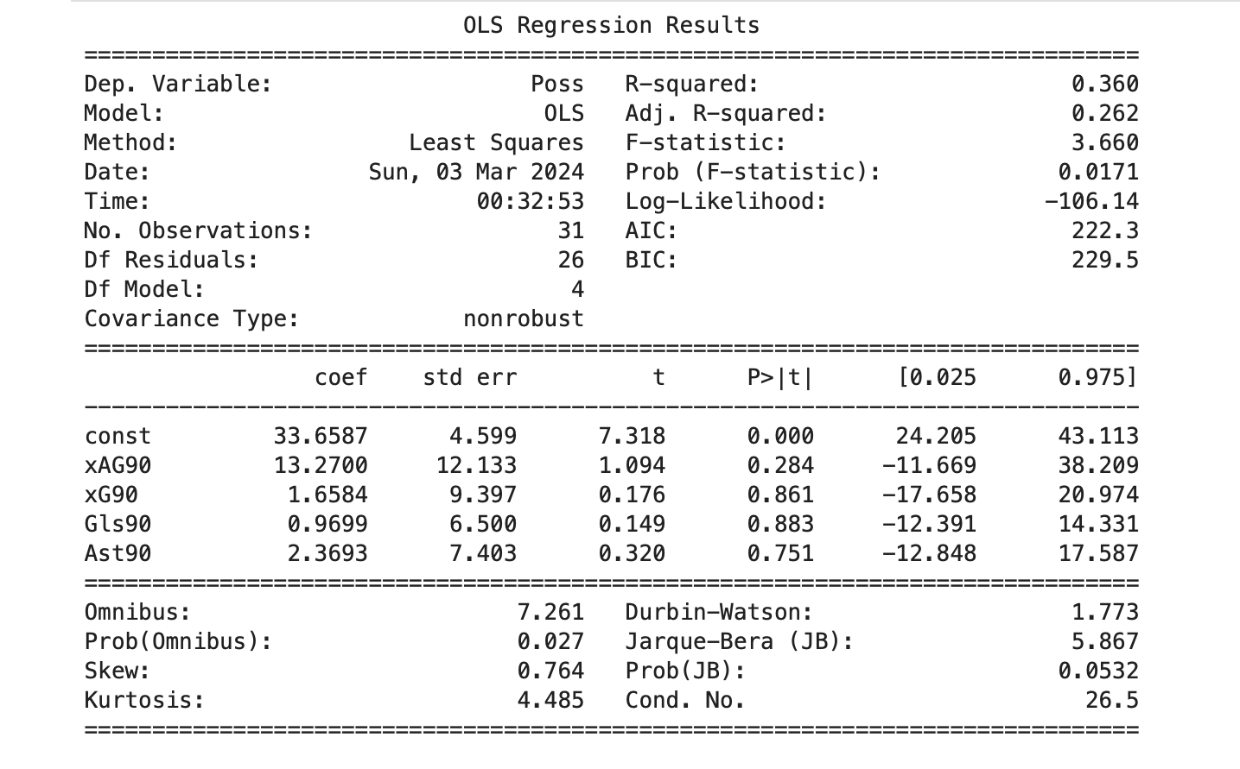
Dataset Regression Analysis: Displays the analytical result for the dataset analysis’ R-Squared Value, F-Statistic and P-Value.

Slide 12
Initial Question/Hypothesis Answer:
Given the data calculated by finding the relationship between the variables in question I believe that the answer is yes. Yes, possession is a slightly over-appreciated statistic within the game. Whilst it is still a necessary event that needs to occur for goals to take place the relationship between the variables and the p-value recorded gives me belief that the opinion I have formed as a result of this EDA is correct.

Slide 13
Thank You for Attending!
Please come forward with any additional questions or concerns at this time!

Slide 14
Reference Page:
Iron486. (2022a, December 18). FIFA World Cup 2022: Complete dataset. Kaggle. https://www.kaggle.com/datasets/die9origephit/fifa-world-cup-2022-complete-dataset

